Slide 1
Chapter 2
Instructions: Language of the Computer
Notes:
The University of Adelaide, School of Computer Science
Chapter 2 — Instructions: Language of the Computer

Slide 2
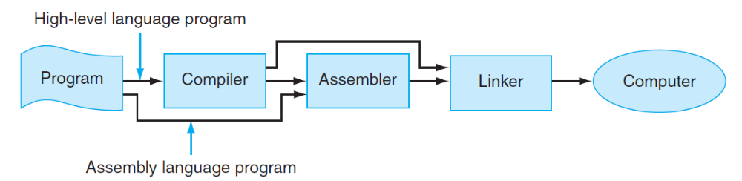
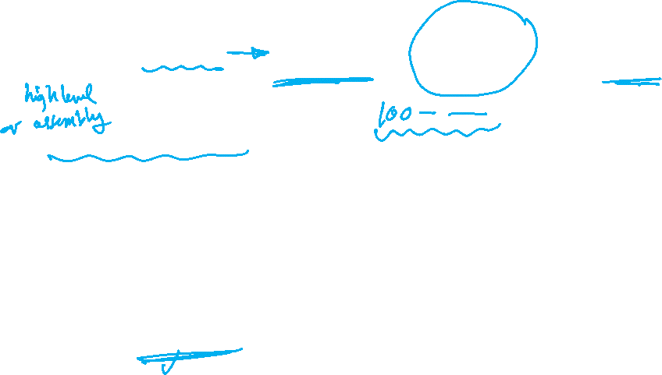
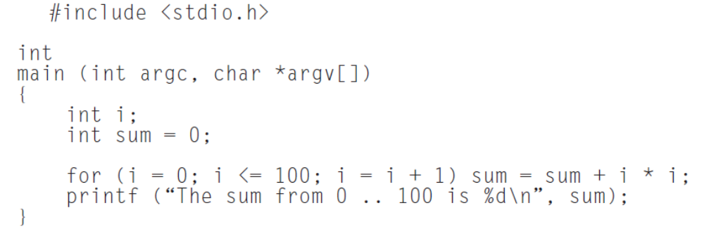
Assembler and Compiler
Chapter 2 — Instructions: Language of the Computer — <number>

Slide 3
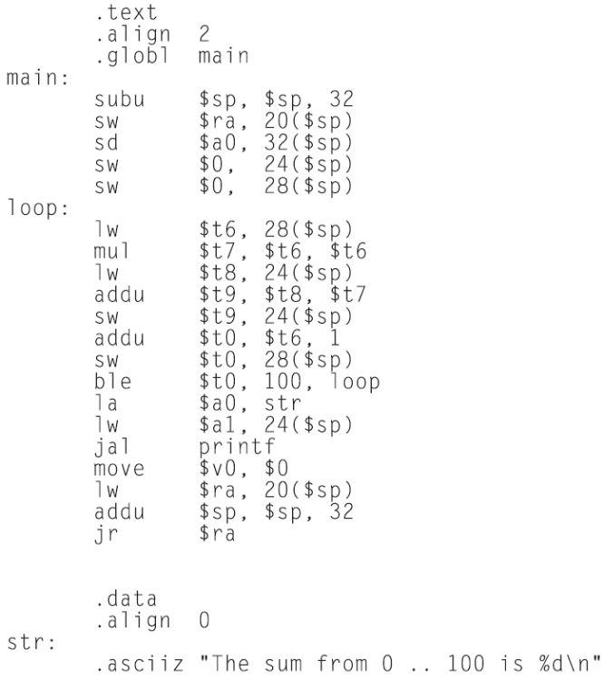

Assembler and Compiler
Chapter 2 — Instructions: Language of the Computer — <number>

Slide 4
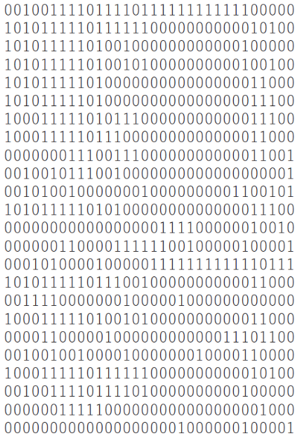

Assembler and Compiler
Chapter 2 — Instructions: Language of the Computer — <number>

Slide 5
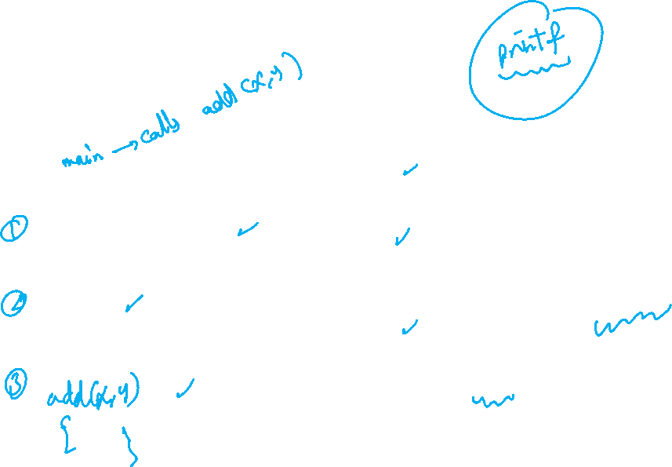
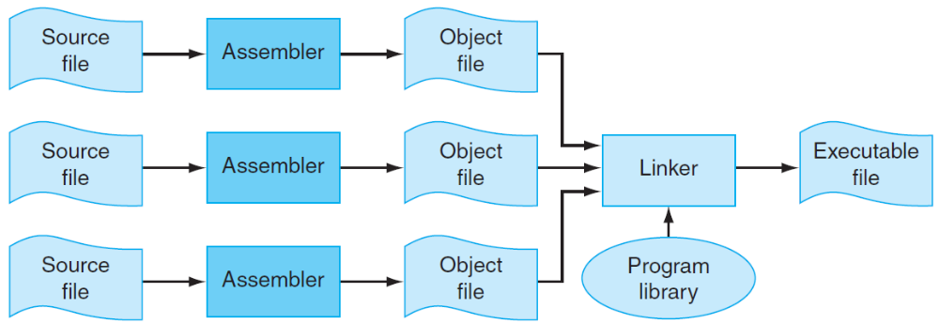
Overall Picture
Chapter 2 — Instructions: Language of the Computer — <number>

Slide 6
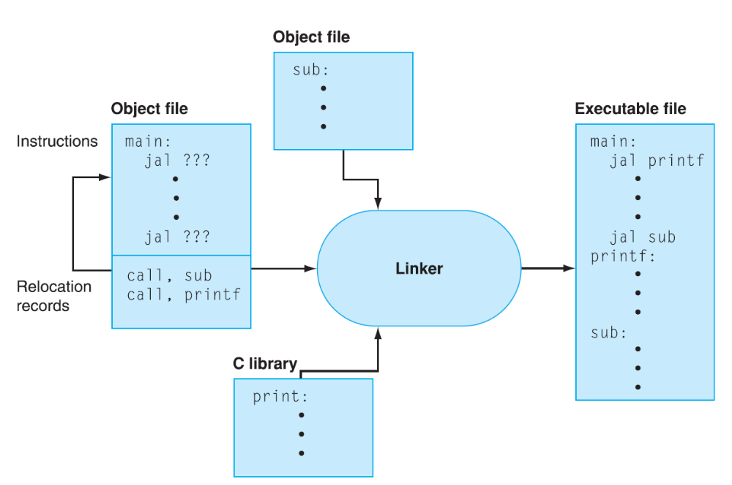
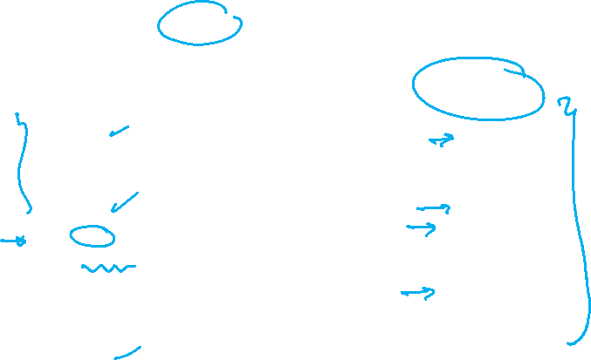
Linker
Chapter 2 — Instructions: Language of the Computer — <number>

